Slide 1
Are country’s Life expectancy and gpd linked
By byte3773045763

Slide 2
Introduction
This post is intended to explore the ideas surrounding the link between the economic output of countries, and the life expectancy of those who live in them between the years of 2000 and 2015. It includes:

Slide 3
Definitions and source
Sources:
Life Expectancy - World Health Organization
GDP - World Bank national accounts data, and OECD National Accounts data files
Definitions:
Life Expectancy - More accurately ‘life expectancy at birth in years’, this represents the predicted age that those who are born in a specific year will live for. Throughout the post, it is commonly abbreviated to LEABY.
GDP - Stands for ‘gross domestic product’ and is a monetary measure of the market value of all final goods and services produced in a time period.
HIC – High income country
NEE – Newley emerging economy
LIC – Low-income country

Slide 4
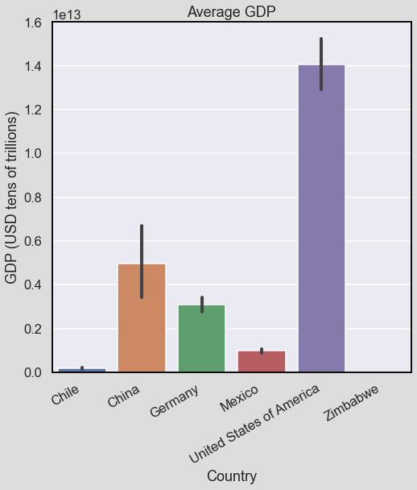
Average gdp
This shows us the average GDP of each of the 6 countries we will be analyzing (Chile, China, Germany, Mexico, USA and Zimbabwe) between the years of 2000 and 2015.
The black bar gives a rough idea of how much each country’s GDP varies over the years.
Zimbabwe’s GDP is so small in comparison to the others that it doesn’t show up.

Slide 5
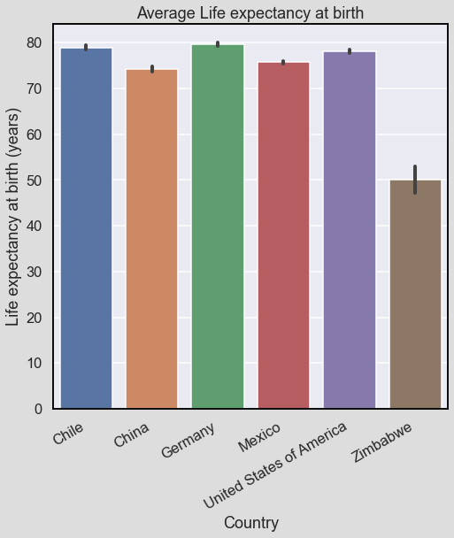
Average LEABY
This bar chart is similar to the last, except the y axis is now life expectancy.
We can see that the average life expectancy between countries is very similar compared to GDP, and that it varies less over the years.
Zimbabwe’s LEABY is also very small in comparison to the others, just like with the GDP.

Slide 6
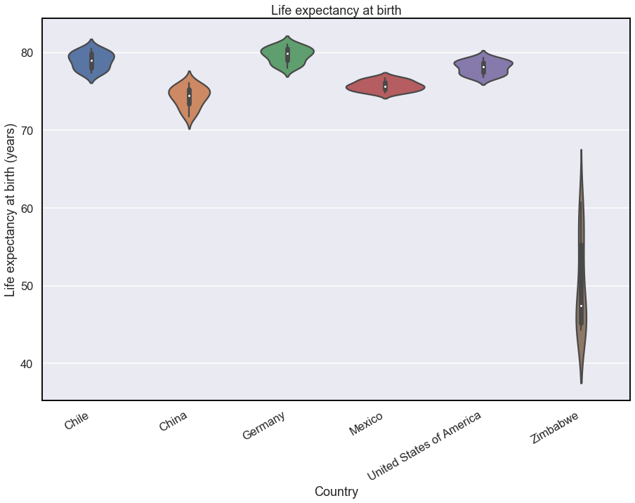
Life expectancy distributions
To dive deeper into the distribution of life expectancy, we can use a violin plot. The width of the violin shows how many recordings were of that value, and the white dot represents the average value.
Here we can see the consistency of most countries, except for Zimbabwe.

Slide 7
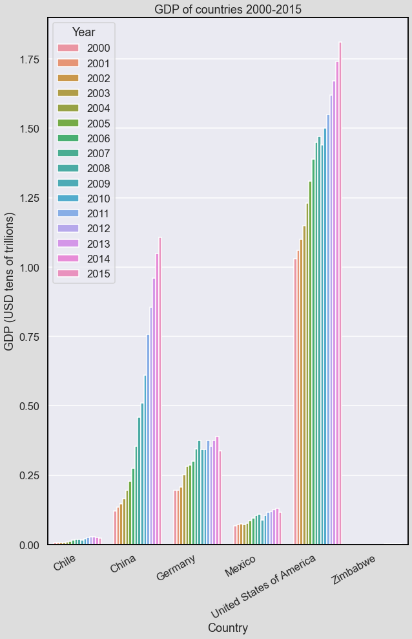
GDP trends
This bar chart represents the trends of the GDP for each country.
This shows us that most countries’ GDP is increasing.
It also tells us that China is growing the fastest: in 2000, it was smaller than Germany’s, but by 2015, it is on course to catch up with Germany. This is an increase in > USD 9 trillion.

Slide 8
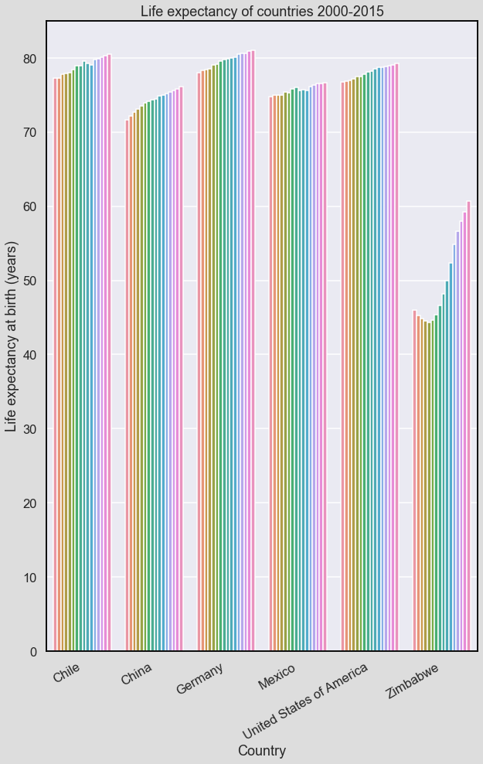
LEABY trends
This bar chart represents the trends of the LEABY for each country.
This shows us that most countries’ LEABY is slowly increasing over time.
China, in comparison to its performance in GDP, is around the 2nd or 3rd worst, even though it increases the second most – 4.4 years.
Zimbabwe is the only country that shows a large downwards trend. Fortunately, this is no longer the case, and its life expectancy is increasing rapidly, it is now 16.4 years higher than in 2000!

Slide 9
How could this be better represented
We have seen the trends of GDP and LEABY in the form of a bar chart, but that isn’t how they would usually be represented.
Instead, a line graph would be more useful in determining trends, as the curves it produces can give us more accurate guesses to how a country will change in the future, as well as estimate data that isn’t in our dataset.
Let’s see how these turn out…

Slide 10
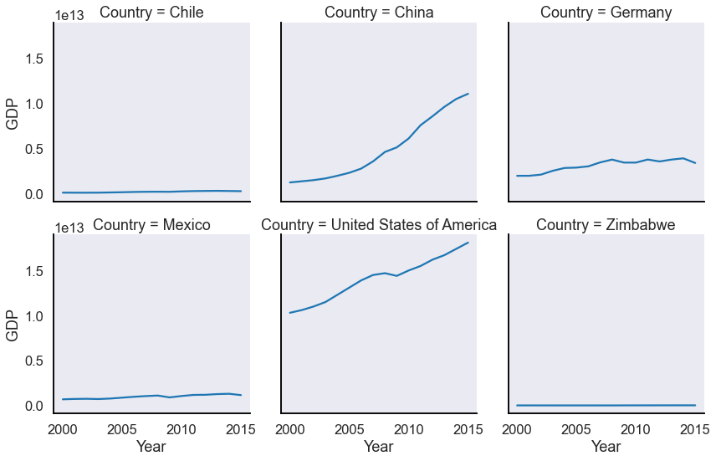
GDP line plots
Unfortunately, just like with the bar graphs, no inferences can be made of the Zimbabwe data, as it is just a straight line.
However, the line graphs give us a good picture of China’s GDP growth, and the prospects for its future if it can continue it’s growth.

Slide 11
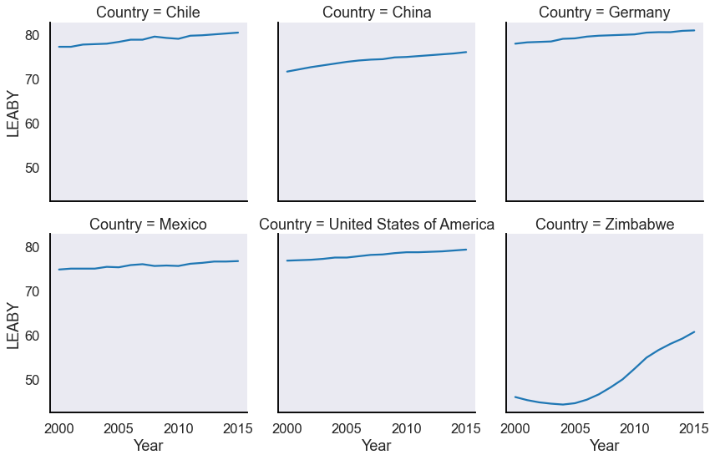
LEABY line plots
These line graphs are a much better representation of each country’s LEABY compared to the bar graphs. This is partially since the line graphs can zoom in close to the tops of each bar graph.
Here we can see that the LEABY of each country seems very stable, other than that of Zimbabwe.

Slide 12
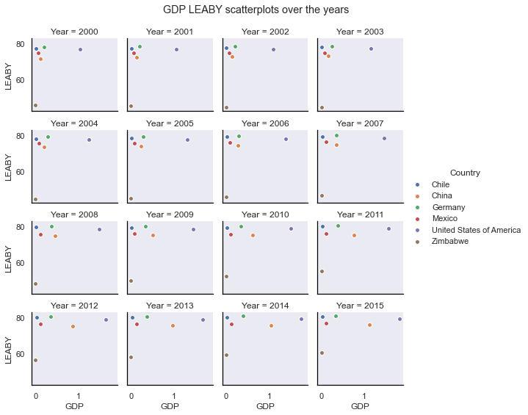
GDP compared to LEABY over time
This graph shows the GDP compared to the LEABY in each country for every year between 2000 and 2015.
The closer to the top right of the graph that a country is, the better it’s performance. For example, we can see that the USA has a very high GDP and LEABY, and is closest to the top right corner in every graph. The opposite is true for Zimbabwe, who remain furthest away in every graph, even though they increase rapidly on the y-axis (LEABY).

Slide 13
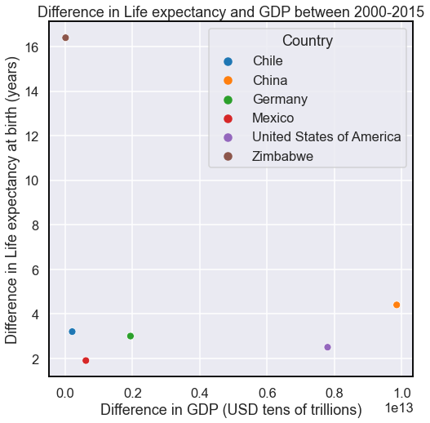
Difference in gdp and leaby
This graph shows the difference in LEABY and GDP between the years of 2000 and 2015.
This enables us to see which countries are developing and which aren’t. For example, we can see that China’s economy is rapidly changing, as its GDP has grown by almost 10 trillion USD in 15 years.
We can also see that whilst Zimbabwe’s LEABY is very low, this is changing in a positive way, its LEABY increasing by over 16 years in 15 years!

Slide 14
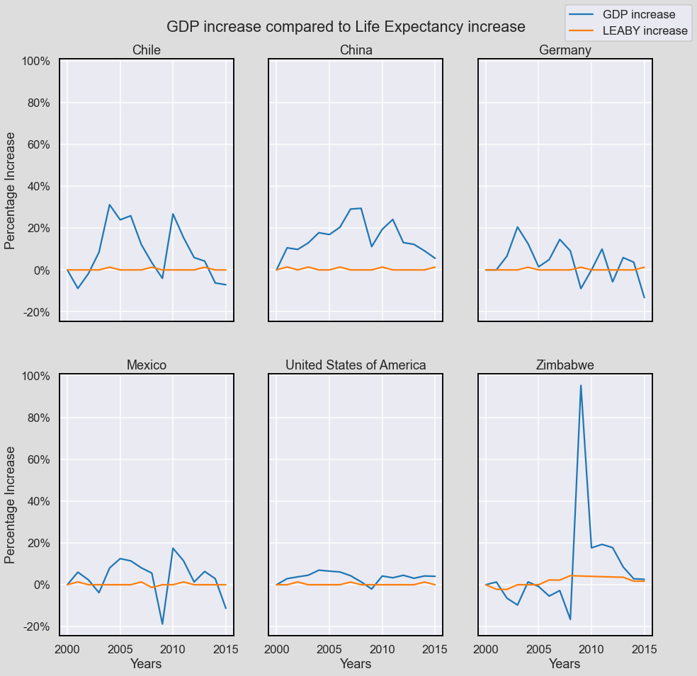
GDP and Leaby percentage increase
These graphs show the percentage increase of each country’s GDP and LEABY every year between 2000 and 2015.
This allows us to see how stable each country’s GDP and LEABY are, and enables us to compare the effects of the GDP on the LEABY and vice versa.
We can see that in Chile, when the LEABY increases, the GDP percentage increase decreases soon after.
The opposite however is true in China, as an increase in LEABY increase, is always followed by an increase in GDP.
Chile is a LIC, and China is a NEE, closer to a HIC. These opposite trends seem to match for each country, USA and Germany are HICs, and follow the same pattern as China, whereas Mexico and Zimbabwe are LICs and follow the same pattern as Chile.

Slide 15
Is this correct?
This suggests that the relationship between Gross Domestic Product and Life Expectancy at Birth in Years depends on how developed a country is:
HICs – A percentage increase in LEABY, may contribute towards a larger percentage increase in GDP.
LICs – A percentage increase in LEABY, may contribute towards a lower percentage increase in GDP.
But does this sound realistic? How could an increase in the length of people’s lives contribute to a growth in GDP, in the space of a year? It may cause an increase in GDP over a longer period of time due to a higher age of retirement, but the sudden impacts that are clear to see, aren’t likely to be affected by this.
So maybe it is the wrong way around? If we look instead at the effects of GDP on LEABY, we can see that a few years after a spike in GDP increase, the LEABY increases. This suggests that a growth in GDP results in an increase in LEABY a few years after the spike. The delay in GDP may also explain the perceived effect an increase in LEABY has on GDP in LICs, as the delayed LEABY increase tends to coincide with the decrease in GDP increase, potentially since a country with it’s newfound wealth and age, may become more satisfied, which in turn may cause a decrease in productivity, and an increase in the amount of people retiring, leading to a decrease in the percentage increase of the GDP of a country. However, this is a study for another time.
Zimbabwe’s graph, however, doesn’t seem to follow many of these patterns, but its graph has been influenced by many other external factors, such as inflation in 2008.

Slide 16
These arrows show the impact of GDP increase on LEABY

Slide 17
These arrows show how the impact on LEABY caused by GDP is always followed by a decrease in GDP increase.
How this works is explained in the next slide.

Slide 18
LEABY increase and GDP decrease correlation explanation
Disclaimer – This is built off assumptions, the only research this is based off is from this presentation.
GDP increases
People get wealthier
Disposable income increases
Less demand for high income jobs
Better healthcare + quality of life improves
More people retire
More tertiary/quaternary jobs
People live for longer
Productivity decreases
Decrease in size of workforce
More senior/high paying job opportunities
More job opportunities
GDP increase slows / GDP decreases
Red box = Previously discussed

